Slide 1
Copyright Year in Review: 2020
Notes:
(Template from Titlehunter.com)

Slide 2
Legislation?
CASE Act
Sen. Tillis: DMCA reform

Slide 3
Copyright Office
1201 Rulemaking
Music Choice v. Copyright Royalty Board, 970 F.3d 418 (D.C. Cir. 2020)

Slide 4
Subject Matter
Georgia v. Public.Resource.Org, Inc., 140 S.Ct. 1498 (2020)
International Code Council, Inc. v. UpCodes, Inc., 2020 WL 2750636 (S.D.N.Y. May 26, 2020)

Slide 5
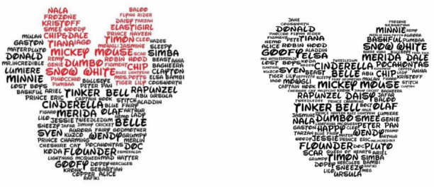
Relativity of title
Notes:
Bork v. Tran Huong Quynh, 2020 WL 4474485 (M.D. Fla. Aug. 4, 2020)

Slide 6
Authorship
Everly v. Everly, 958 F.3d 442 (6th Cir. 2020)

Slide 7
Infringement
McGucken v. Newsweek LLC, 464 F.Supp.3d 594 (SDNY 2020)
Skidmore as Trustee for Randy Craig Wolfe Trust v. Led Zeppelin, 952 F.3d 1051 (9th Cir. 2020)
Cortes v. Universal Music Latino, --- F.Supp.3d ---- (S.D. Fla. 2020) (“Despacito” or “Despasito”)
Gray v. Perry, 2020 WL 1275221 (C.D. Cal. Mar. 16, 2020)
Compulife Software Inc. v. Newman, 959 F.3d 1288 (11th Cir. 2020)
SAS Institute Inc. v. World Programming Limited, 2020 WL 6271230 (E.D. Tex. Oct. 26, 2020)

Slide 8
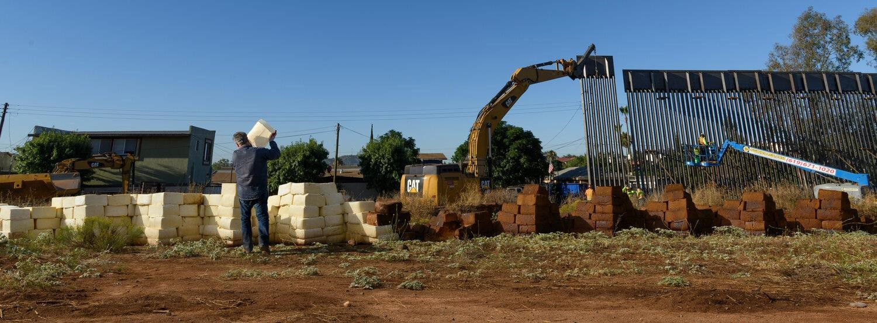
Moral Rights
Cavallaro v. SLSCO, Ltd., No. 20-cv-02157-WQH-AGS (S.D. Cal. filed Nov. 4, 2020)

Slide 9
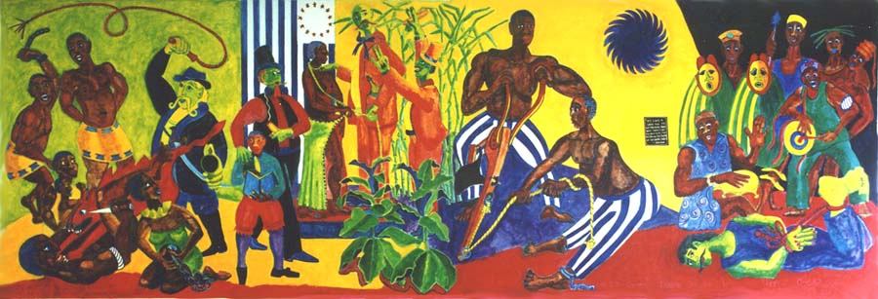
Sam Kerson mural, The Underground Railroad Vermont and the Fugitive Slave
Notes:
http://www.samkerson.com/murals/undergroundmural.html, Photos by Phillip Danzig

Slide 10
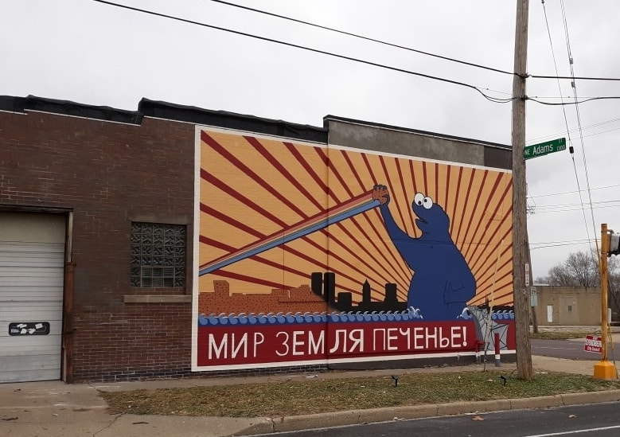
Upcoming issue: removing permissionless art
Notes:
https://news.artnet.com/art-world/soviet-style-cookie-monster-mural-1929712

Slide 11
Fair Use
Chapman v. Maraj, 18-cv-09088-VAP-SS (C.D. Cal. Sept. 16, 2020): “experimental use” comes to copyright
Estate of Smith v. Graham, 799 Fed.Appx. 36 (2d Cir. 2020): more musical fair use
Hughes v. Benjamin, 437 F.Supp.3d 382 (S.D.N.Y. 2020)

Slide 12
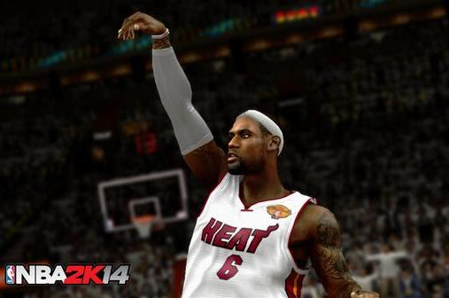
Dueling tattoo cases
Solid Oak Sketches, LLC v. 2K Games, Inc., 1:16-CR-00724-LTS-SDA (S.D.N.Y. March 26, 2020) (also de minimis use and implied license)
Alexander v. Take-Two Interactive Software, Inc., No. 18-CV-966 (S.D. Ill. Sept. 26, 2020) (ditto, but opposite results))

Slide 13
Some love for educational uses?
Tresóna Multimedia, LLC v. Burbank High School Vocal Music Ass’n, 953 F.3d 638 (9th Cir. 2020) (remand on fees!)
See also Bell v. Worthington City School District, 2020 WL 2905803 (S.D. Ohio Jun. 2, 2020)

Slide 14
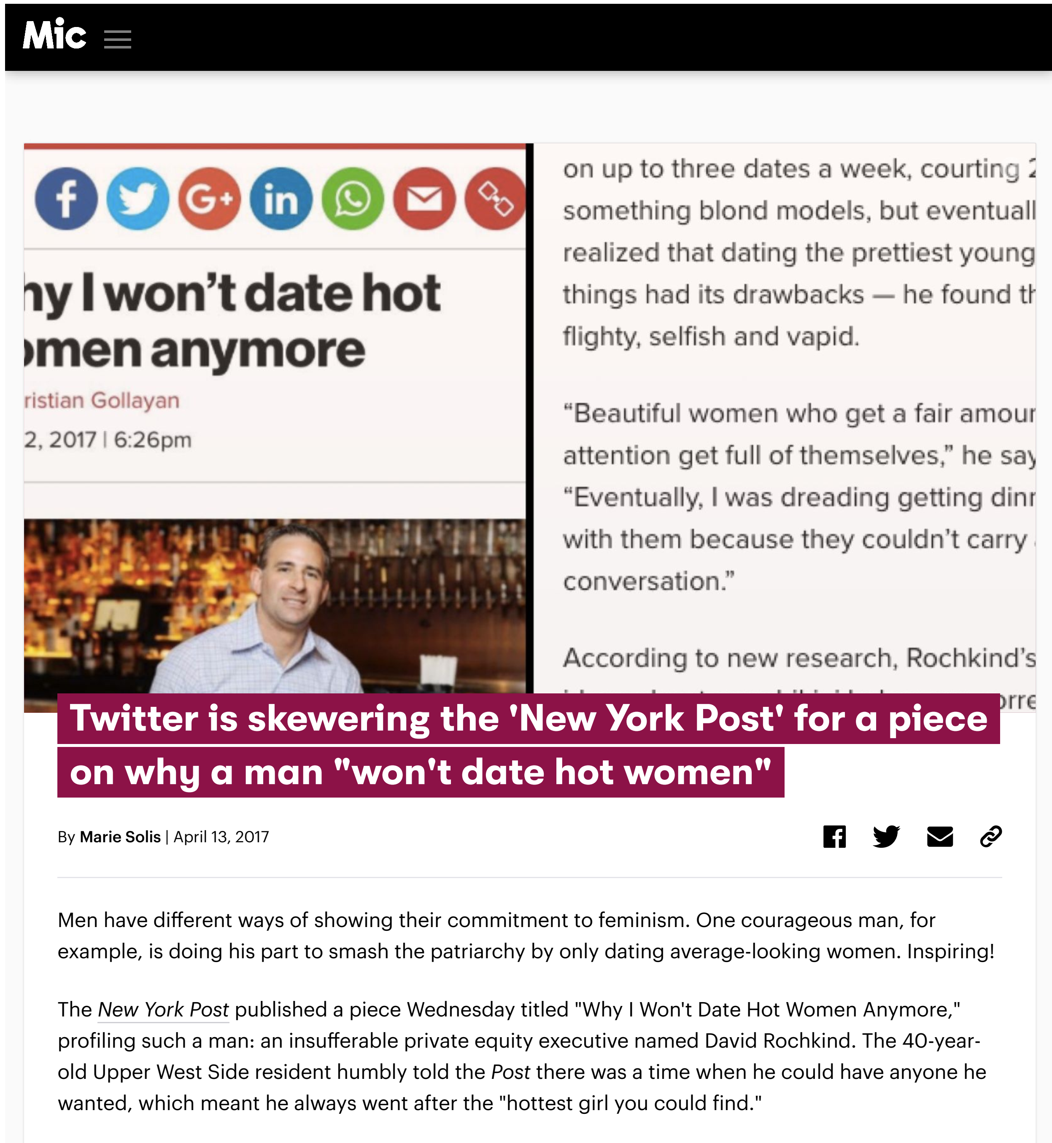
Yang v. Mic Network, Inc., 2020 WL 6562403 (S.D.N.Y. Nov. 9, 2020)

Slide 15
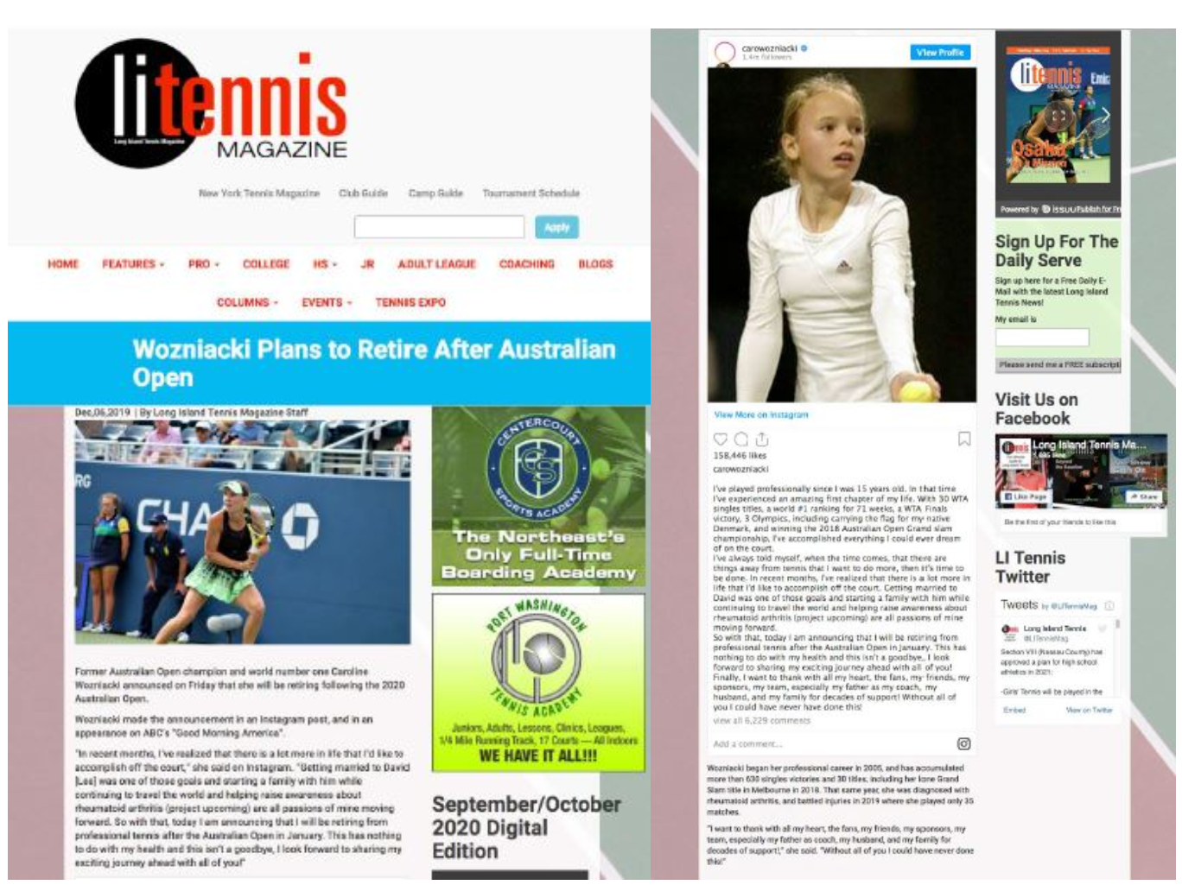
Boesen v. United Sports Publications, Ltd., No. 20-cv-01552-ARR-SIL (E.D.N.Y. Nov. 2, 2020)
Notes:
Original photo on L, screenshot of article with embedded Instagram post

Slide 16
Walsh v. Townsquare Media, Inc., 464 F.Supp.3d 570 (S.D.N.Y. 2020)

Slide 17
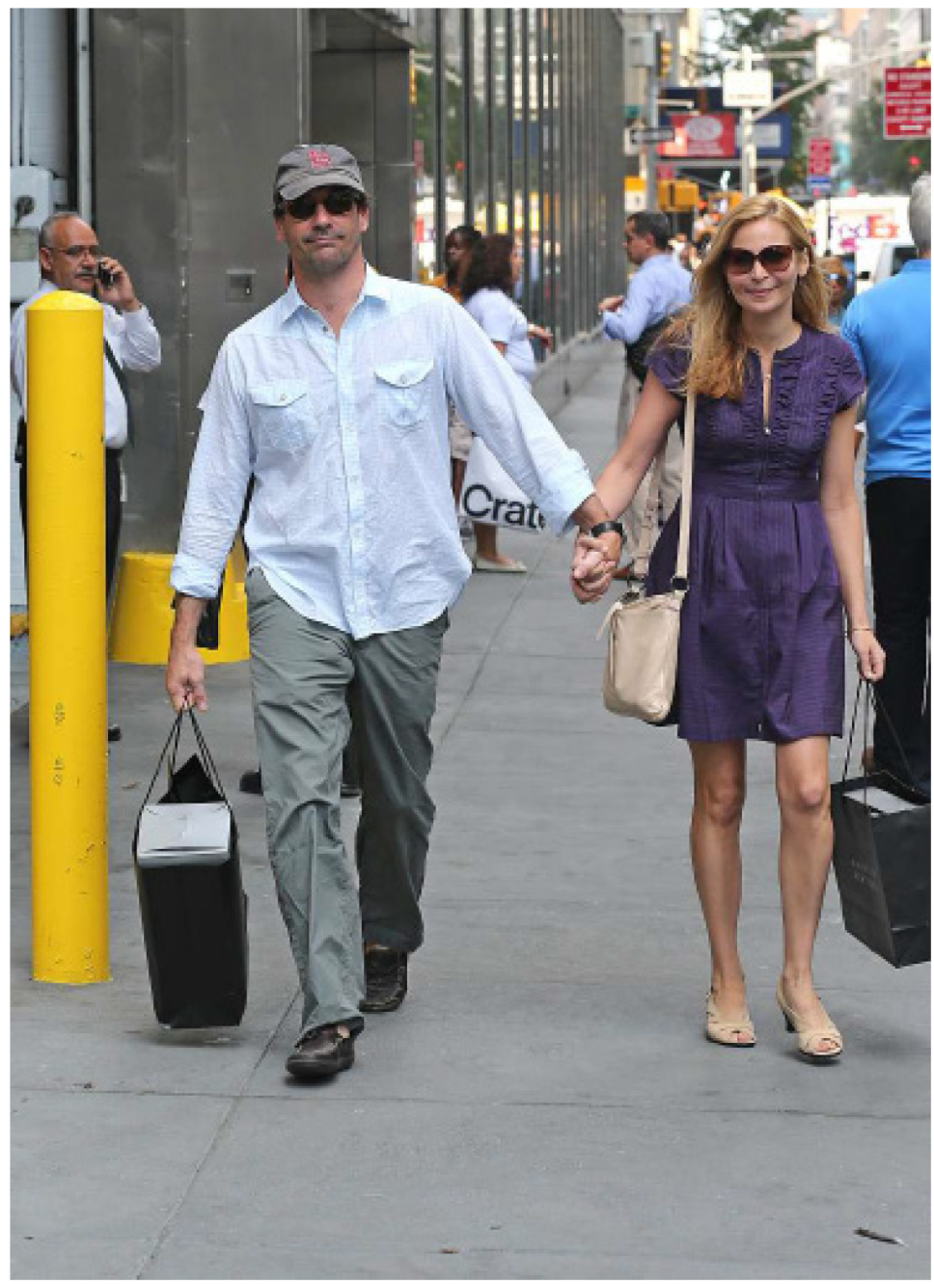
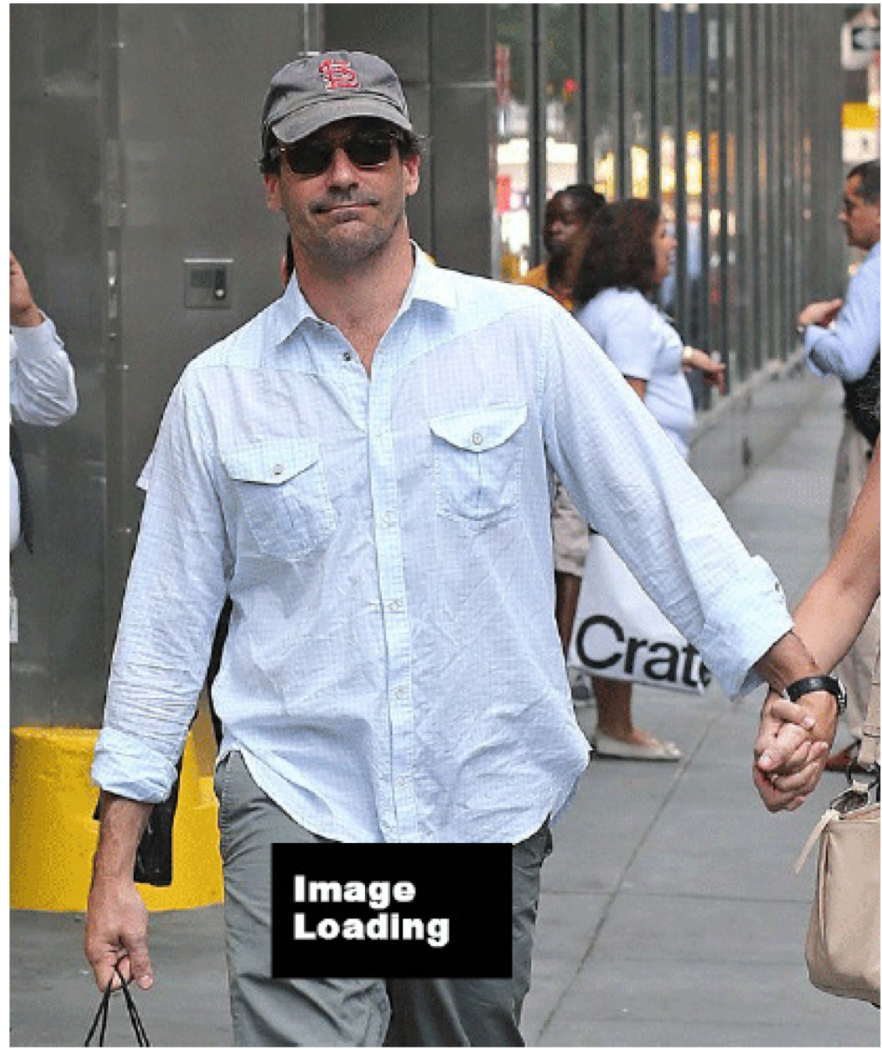
Schwartzwald v. Oath Inc., No. 19-CV-9938 (RA) (S.D.N.Y. Sept. 10, 2020)
Notes:
Original photo (L) and as altered in D’s article (R)

Slide 18
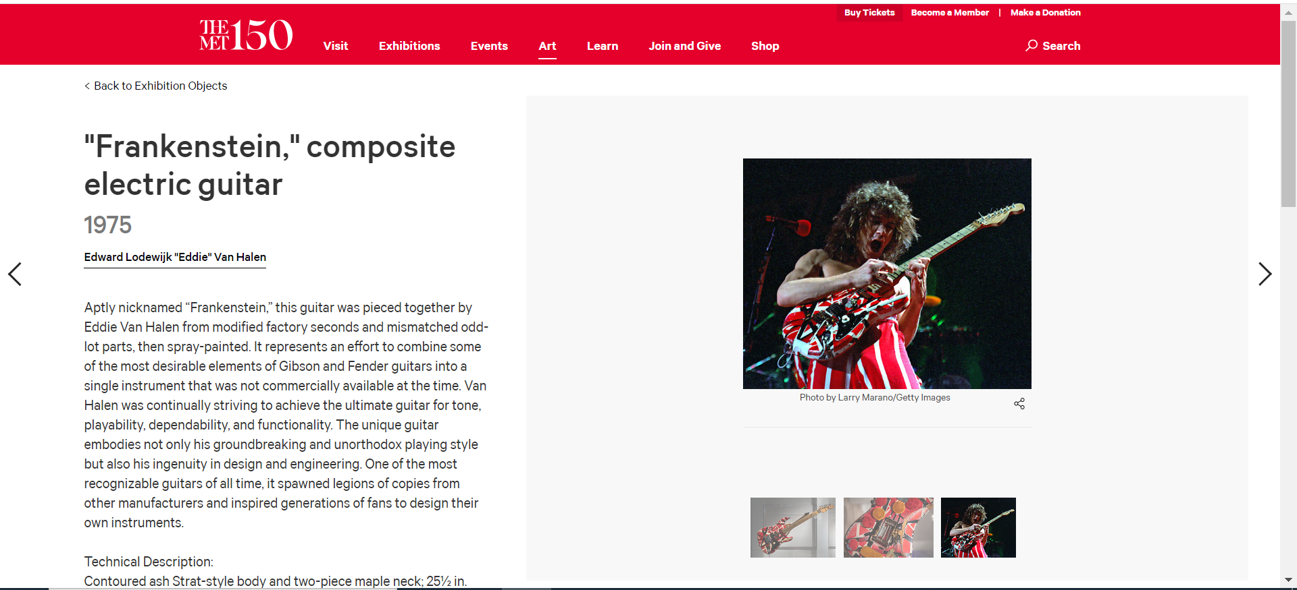
Marano v. Metropolitan Museum of Art, --- F.Supp.3d ----, 2020 WL 3962009 (S.D.N.Y. 2020)

Slide 19
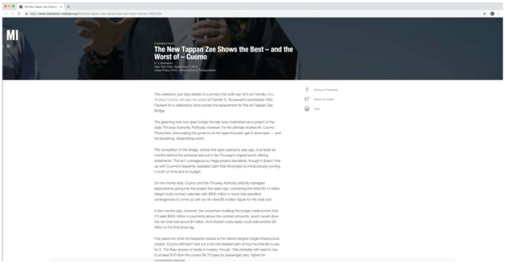
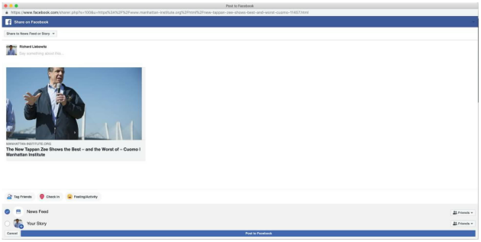
Harbus v. Manhattan Institute for Policy Research, Inc. 2020 WL 1990866 (S.D.N.Y. Apr. 27, 2020)
Notes:
Original on R; two challenged uses on L

Slide 20
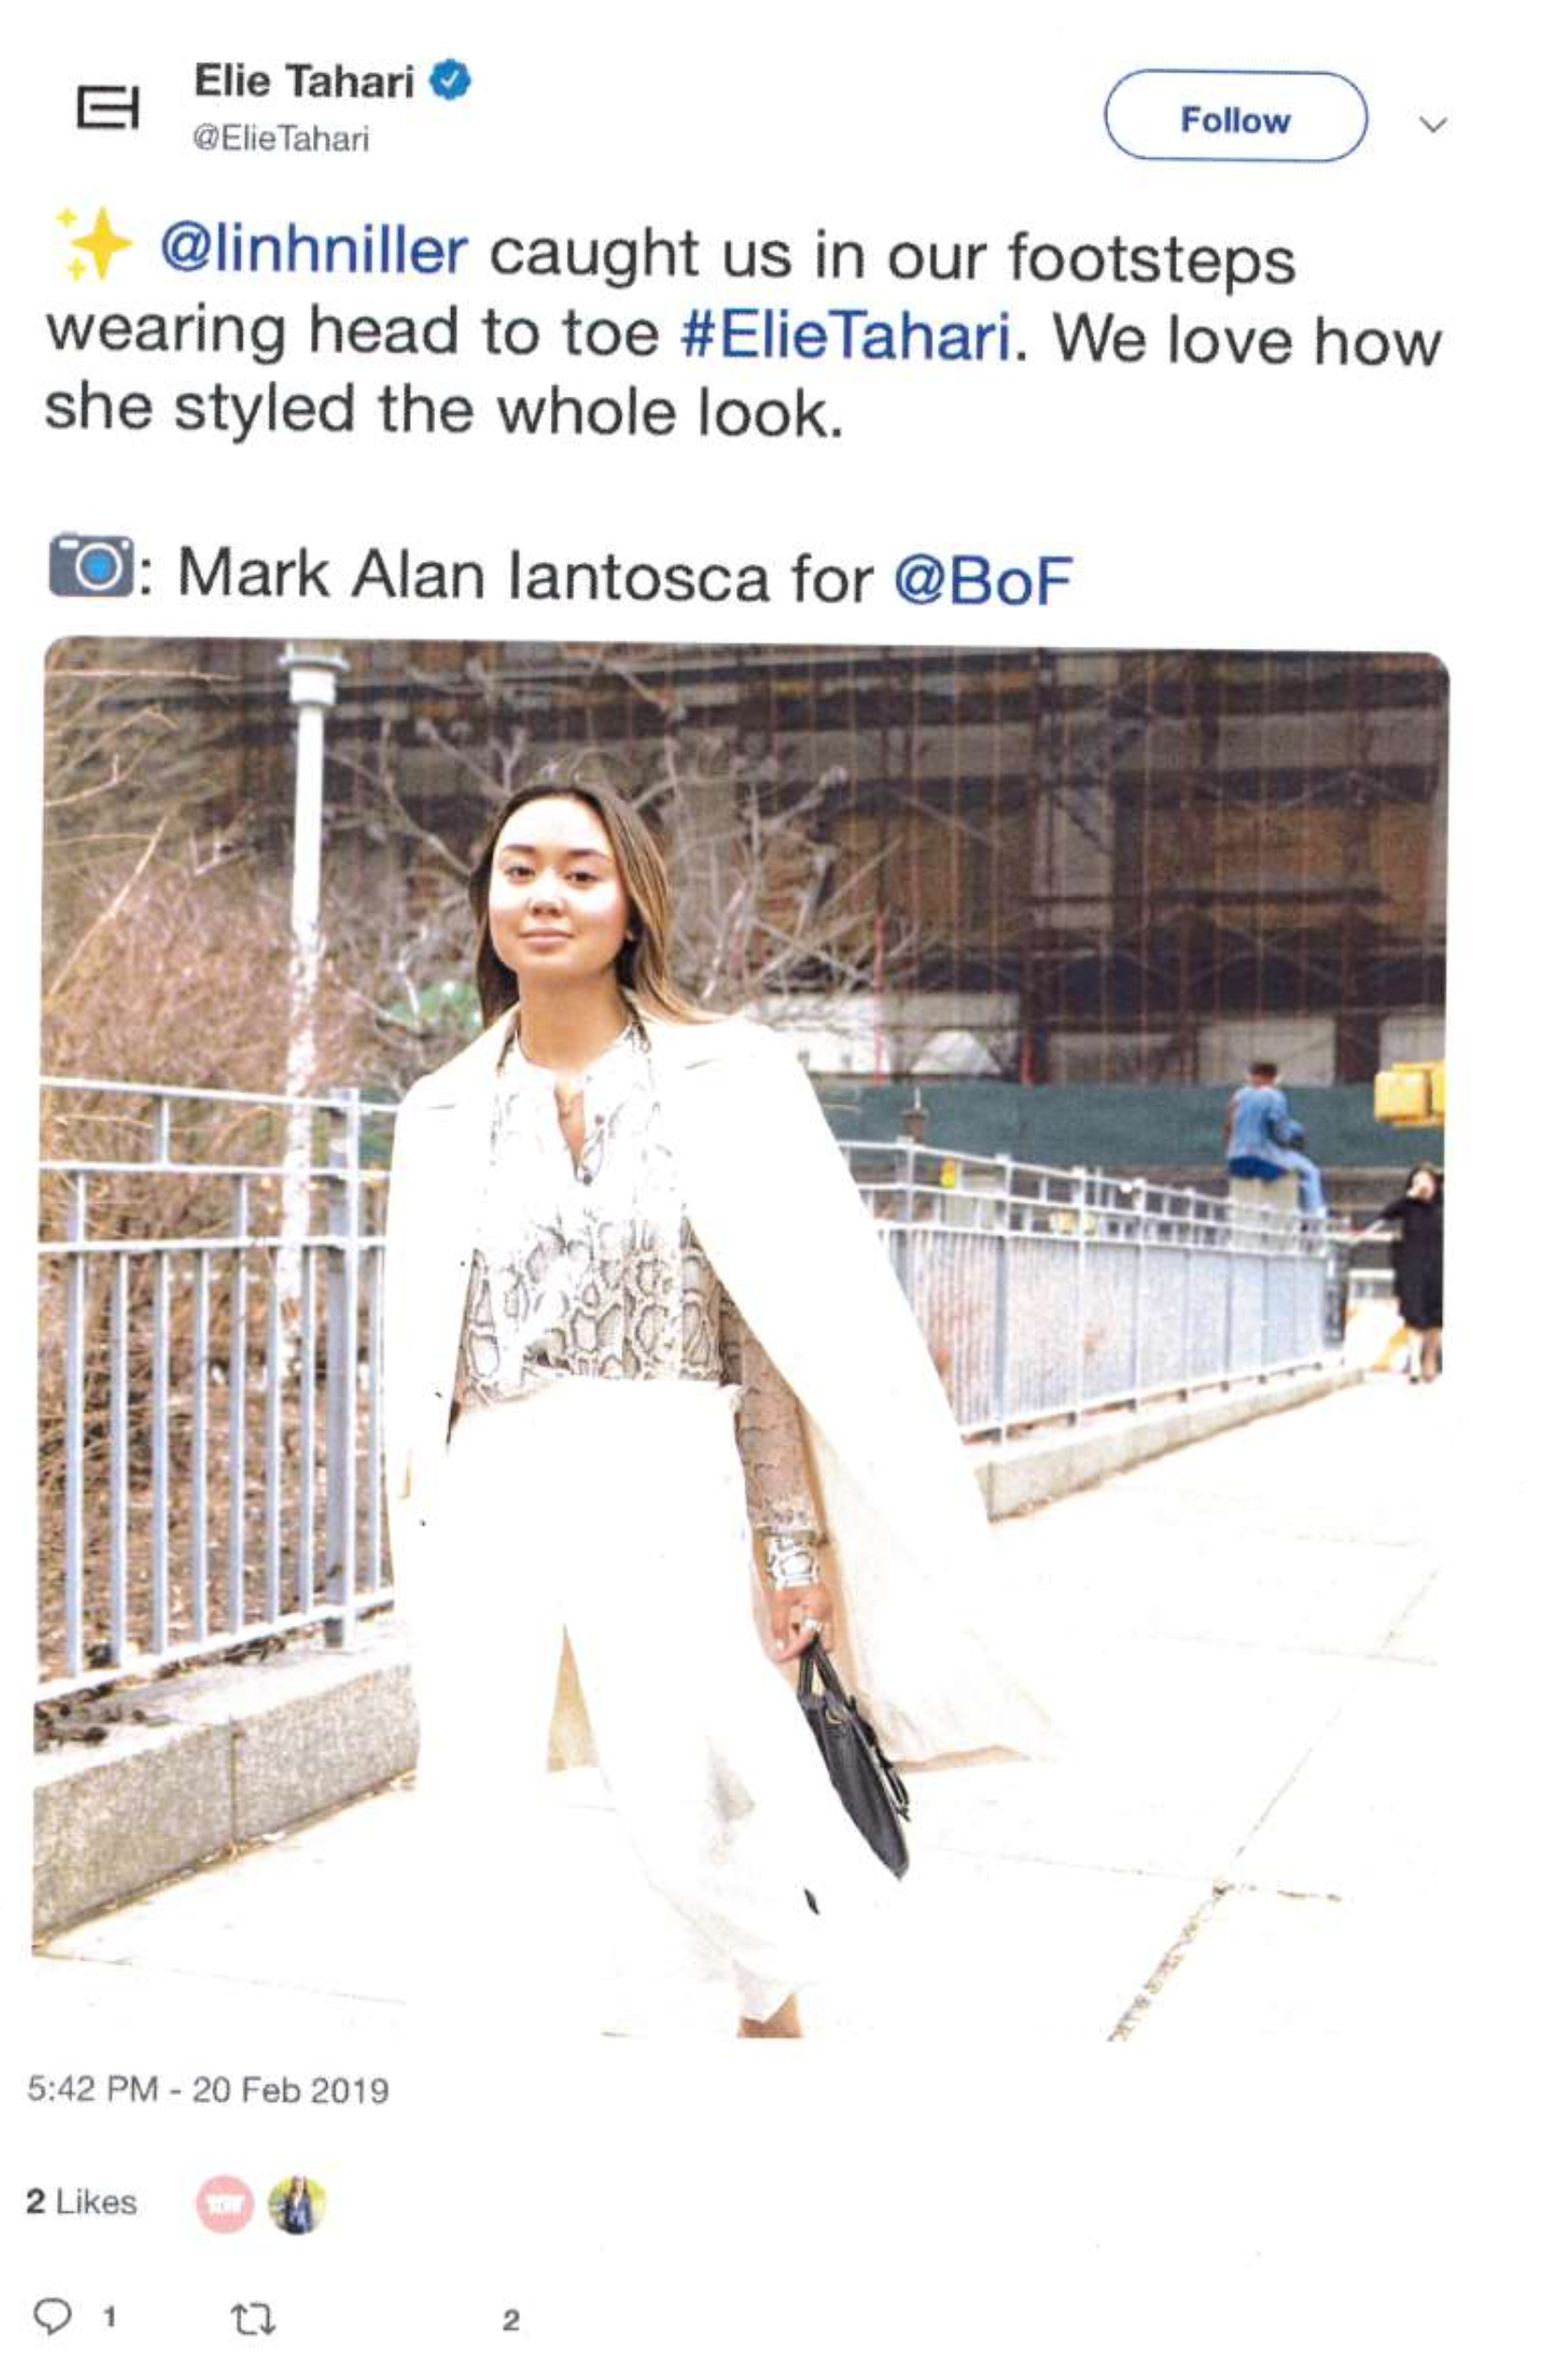
Liebowitz won a few
Iantosca v. Elie Tahari, Ltd., 2020 WL 5603538 (S.D.N.Y. Sept. 18, 2020)
Also
Cruz v. Cox Media Group, LLC, 444 F.Supp.3d 457 (E.D.N.Y. 2020) and

Slide 21
Otto v. Hearst Communications, Inc., 2020 WL 377479 (S.D.N.Y. Jan. 23, 2020)
[T]he Court agrees with Hearst that a “presumptive entitlement” to attorney's fees in cases where a plaintiff successfully asserts infringement of a low-value copyright is at odds with the Supreme Court's decisions in Fogerty and Kirtsaeng. … The protection of copyright is an important value, but there is little benefit to the copyright law in rewarding Otto for prolonging litigation in pursuit of an unjustifiably inflated claim.

Slide 22
Grant v. Trump, No. 20-cv-07103 (S.D.N.Y. filed Sept. 1, 2020)

Slide 23
Secondary Liability
Warner Records Inc. v. Charter Communications, Inc., 454 F.Supp.3d 1069 (2020)
UMG Recordings, Inc. v. RCN Telecom Services, LLC, 2020 WL 5204067 (D.N.J. Aug. 30, 2020)
UMG Recordings, Inc. v. Bright House Networks, LLC, 2020 WL 3957675 (M.D. Fla. Jul. 8, 2020)
ALS Scan, Inc. v. Steadfast Networks, LLC, 819 Fed.Appx. 522 (2020)

Slide 24
512(f)
Beyond Blond Productions, LLC v. Heldman, 2020 WL 4772796 (C.D. Cal. Aug. 17, 2020)

Slide 25
17 U.S. Code § 1202.Integrity of copyright management information
(a) False Copyright Management Information.—No person shall knowingly and with the intent to induce, enable, facilitate, or conceal infringement—
(1) provide copyright management information that is false, or
(2) distribute or import for distribution copyright management information that is false.
(b) Removal or Alteration of Copyright Management Information.—No person shall, without the authority of the copyright owner or the law—
(1) intentionally remove or alter any copyright management information,
(2) distribute or import for distribution copyright management information knowing that the copyright management information has been removed or altered without authority of the copyright owner or the law, or
(3) distribute, import for distribution, or publicly perform works, copies of works, or phonorecords, knowing that copyright management information has been removed or altered without authority of the copyright owner or the law,
knowing, or, with respect to civil remedies under section 1203, having reasonable grounds to know, that it will induce, enable, facilitate, or conceal an infringement of any right under this title.

Slide 26
1202 Arrives
Mango v. BuzzFeed, Inc., 970 F.3d 167 (2d Cir. 2020)
Recif Resources, LLC v. Juniper Capital Advisors, L.P., 2020 WL 5739138 (S.D. Tex. Sept. 24, 2020)
Fischer v. Forrest, 968 F.3d 216 (2d Cir. 2020)
Mills v. Netflix, Inc., 2020 WL 548558 (C.D. Cal. Feb. 3, 2020)
Kirk Kara Corp. v. Western Stone and Metal Corp., 2020 WL 5991503 (C.D. Cal. Aug. 14, 2020)
Pilla v. Gilat, 2020 WL 1309086 (S.D.N.Y. Mar. 19, 2020)

Slide 27
Remedies
Greg Young Publishing, Inc. v. Zazzle, 2020 WL 3871451 (C.D. Cal. Jul. 9, 2020) (now on appeal)
Disney Enterprises, Inc. v. VidAngel, 2020 WL 2738233 (C.D. Cal. Mar. 31, 2020)
Energy Intelligence Group, Incorporated v. Kayne Anderson Capital Advisors, L.P.;, 948 F.3d 261 (5th Cir. 2020)

Slide 28
Licensing
Tresóna: [E]ven if an exclusive right is shared between two entities, a sole owner can promise exclusivity to just those two, while a co-owner cannot make that same promise unilaterally. … The district court correctly held that Tresóna lacked standing under 17 U.S.C. § 501(b) to bring copyright infringement claims based on the songs “(I’ve Had) The Time of My Life,” “Hotel California,” and “Don’t Phunk With My Heart,” as Tresóna received its interests in those songs from individual co-owners of copyright, without the consent of the other co-owners, and therefore held only non-exclusive licenses in those works.

Slide 29
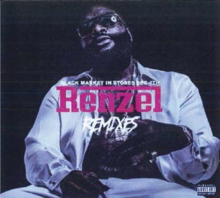
Preemption
Jackson v. Roberts, No. 19-480 (2d Cir. Aug. 19, 2020) Conflict preemption arrives!

